Slide 1
Fitness tracker system
by : Divya shree k

Slide 2
WHY FITNESS TRACKER ?
Helps monitor fitness progress
Promotes a healthier lifestyle
Provides data-driven insights.
OBJECTIVE:
To showcase a web-based fitness tracker that combines data management and machine learning.

Slide 3
Features of the system
User Authentication
Dashboard
Prediction
Reports
Data Visualization

Slide 4
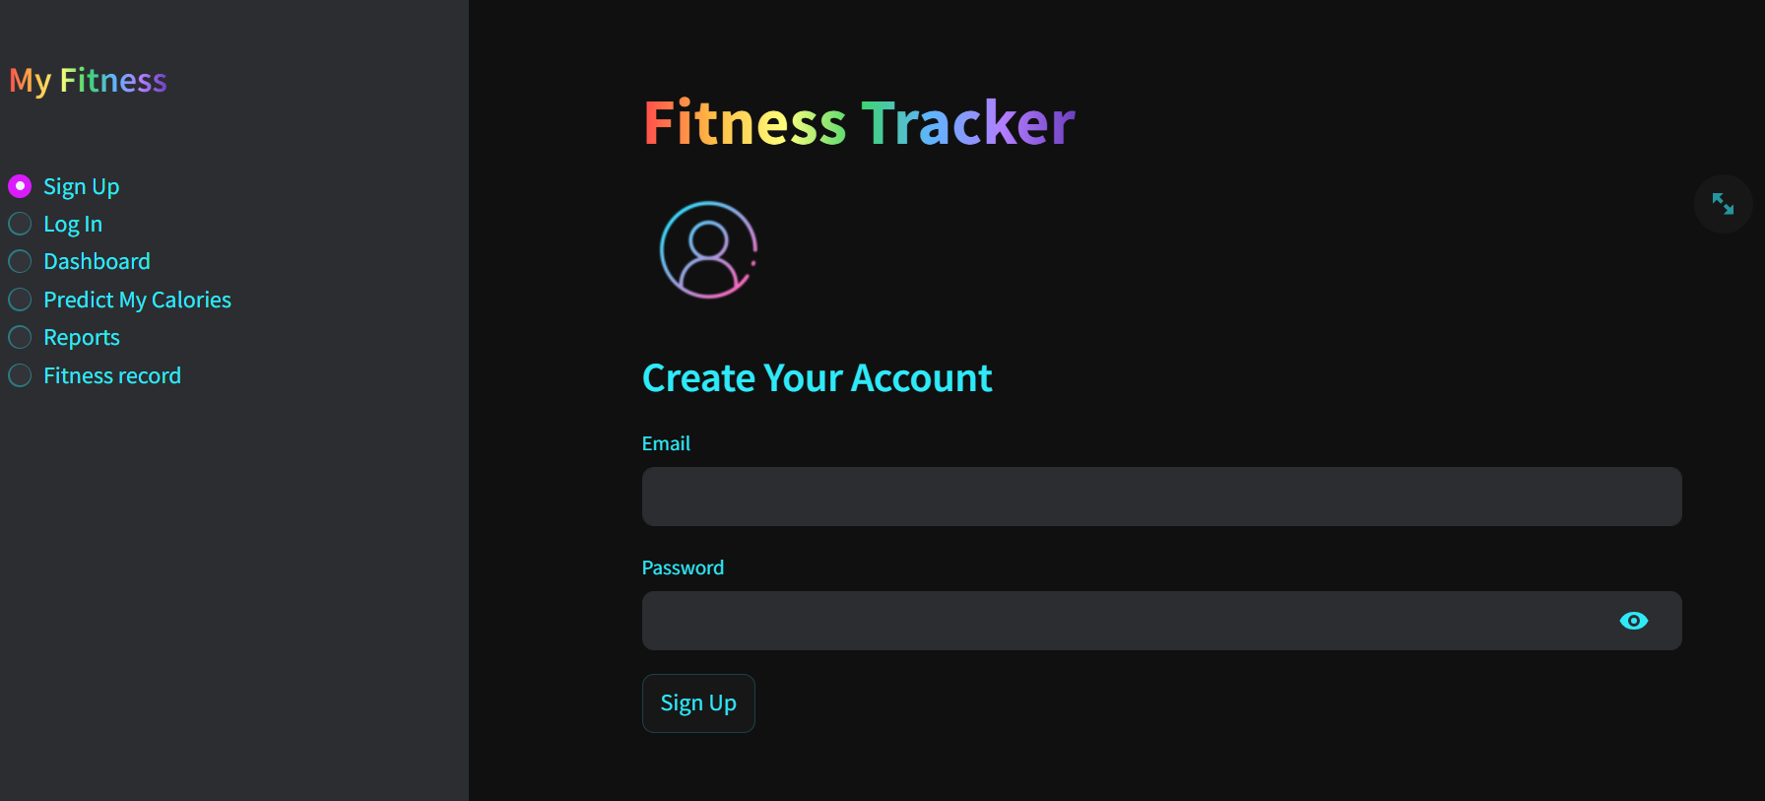
User authentication
Sign up: new user can register by email and password.The credential are securely stored in firestore.

Slide 5
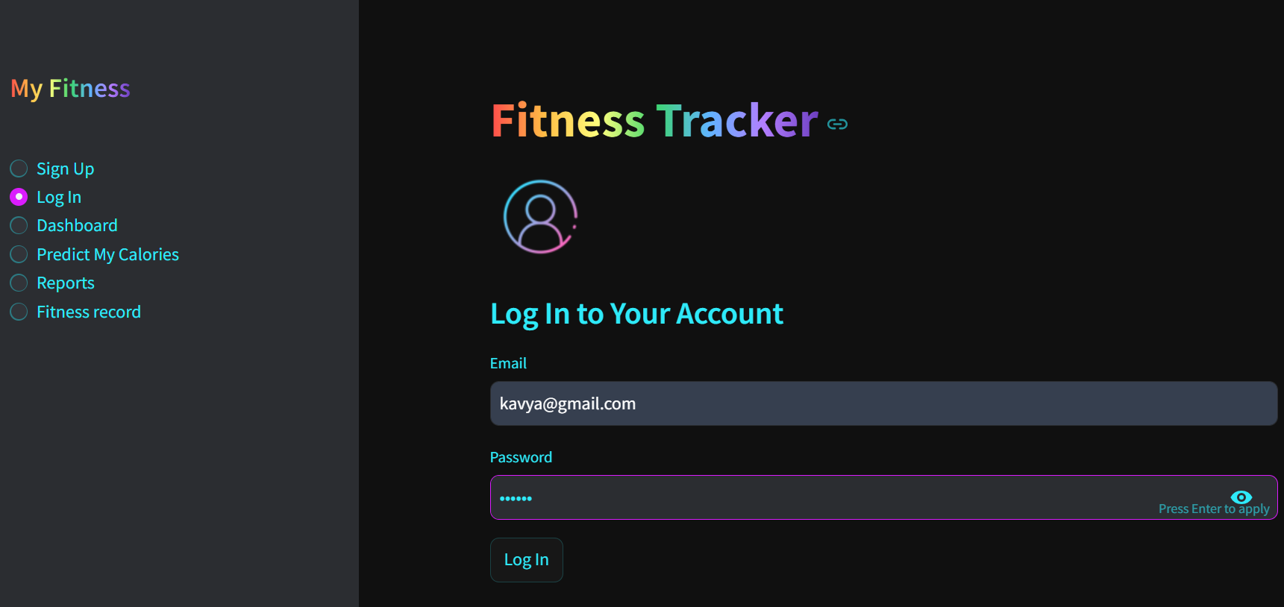
User authentication
Log in : Existing users can access their personalized dashboard by entering with valid credentials.

Slide 6
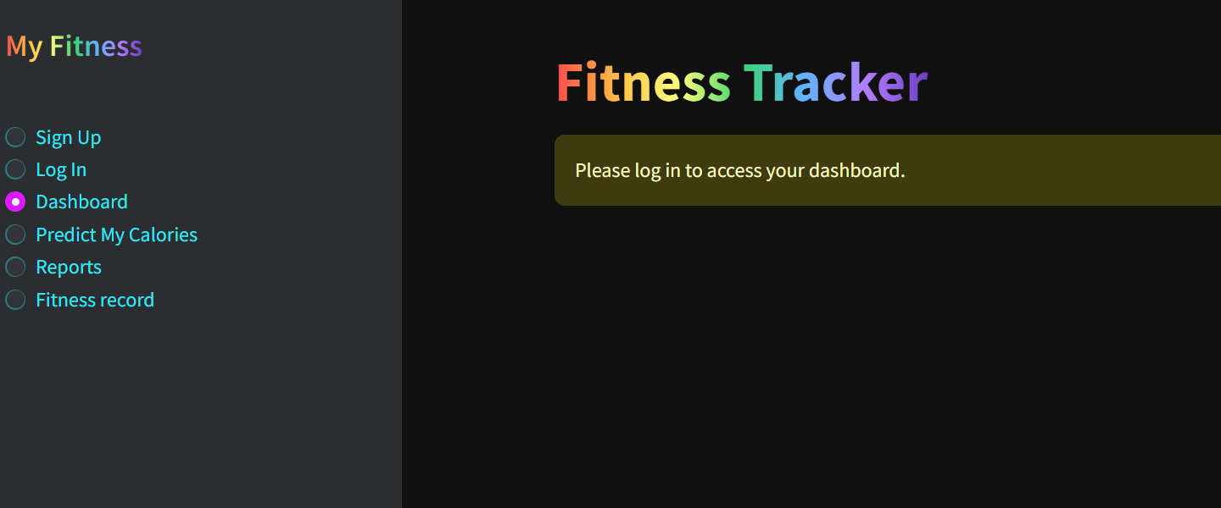

Slide 7
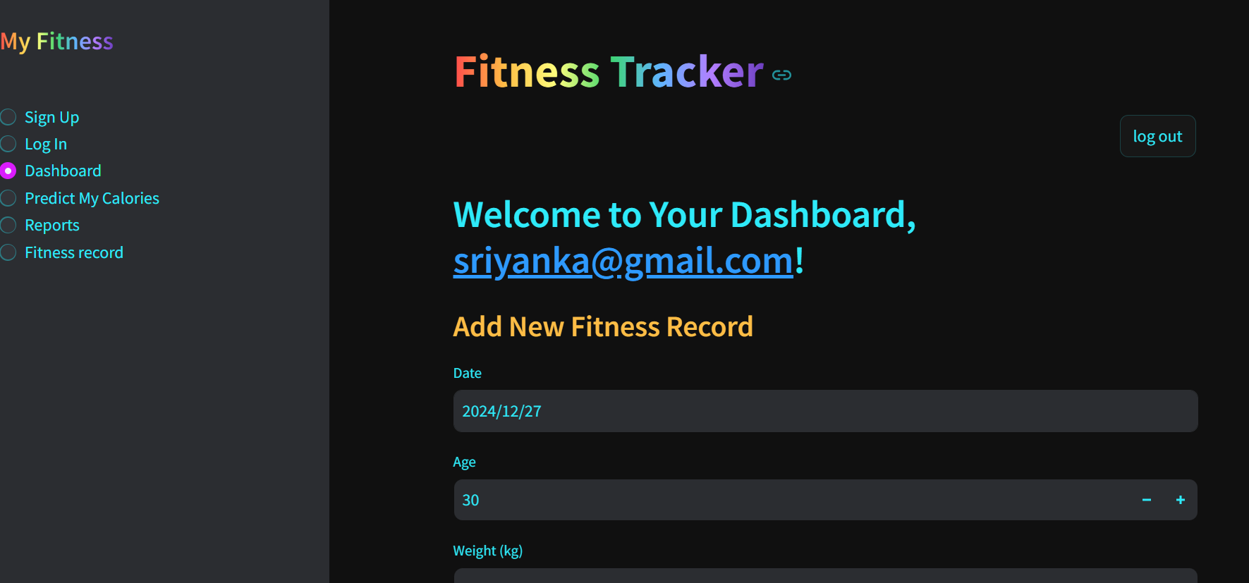
Dashboard

Slide 8
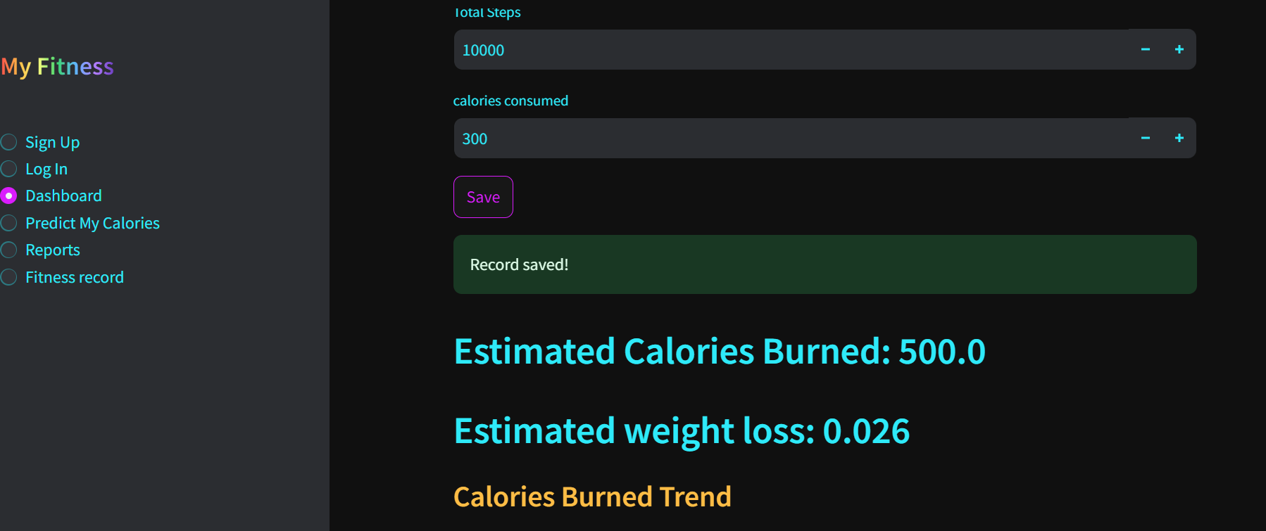
Dashboard

Slide 9
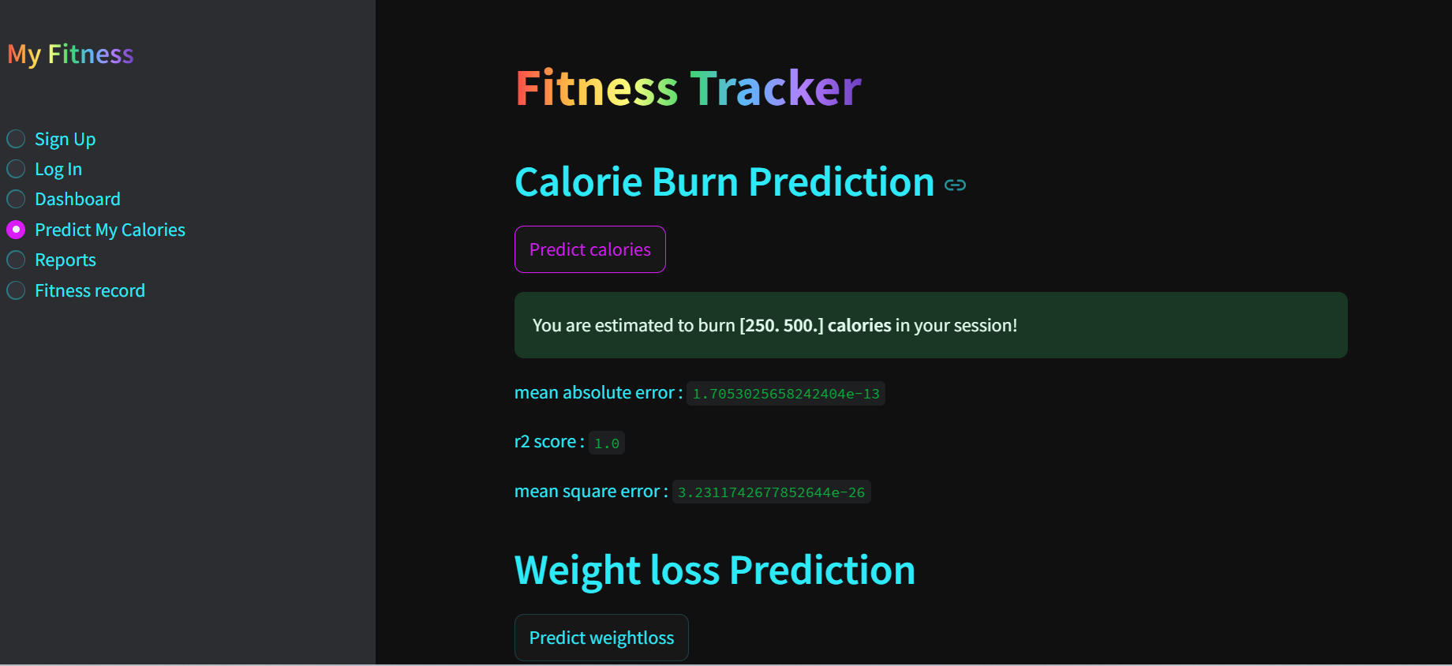
Prediction system

Slide 10
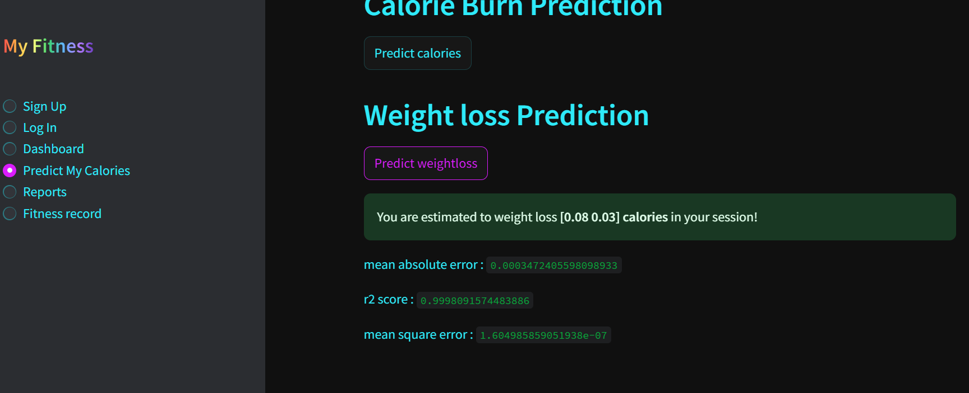
Prediction system

Slide 11
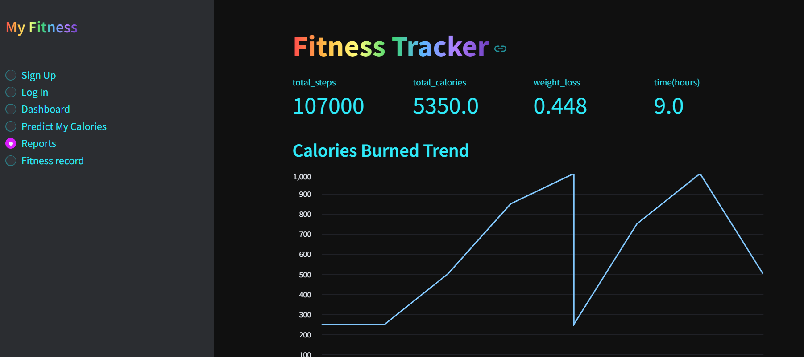
Reports
Keys metrics: total steps, calories burned weight loss session duration.
Displays : line and bar chart to showcase calories total steps over a duration.

Slide 12
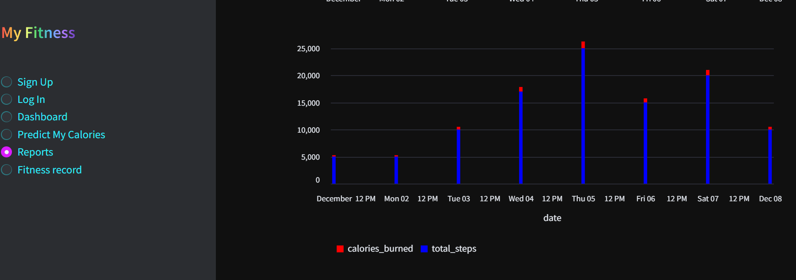
Reports

Slide 13
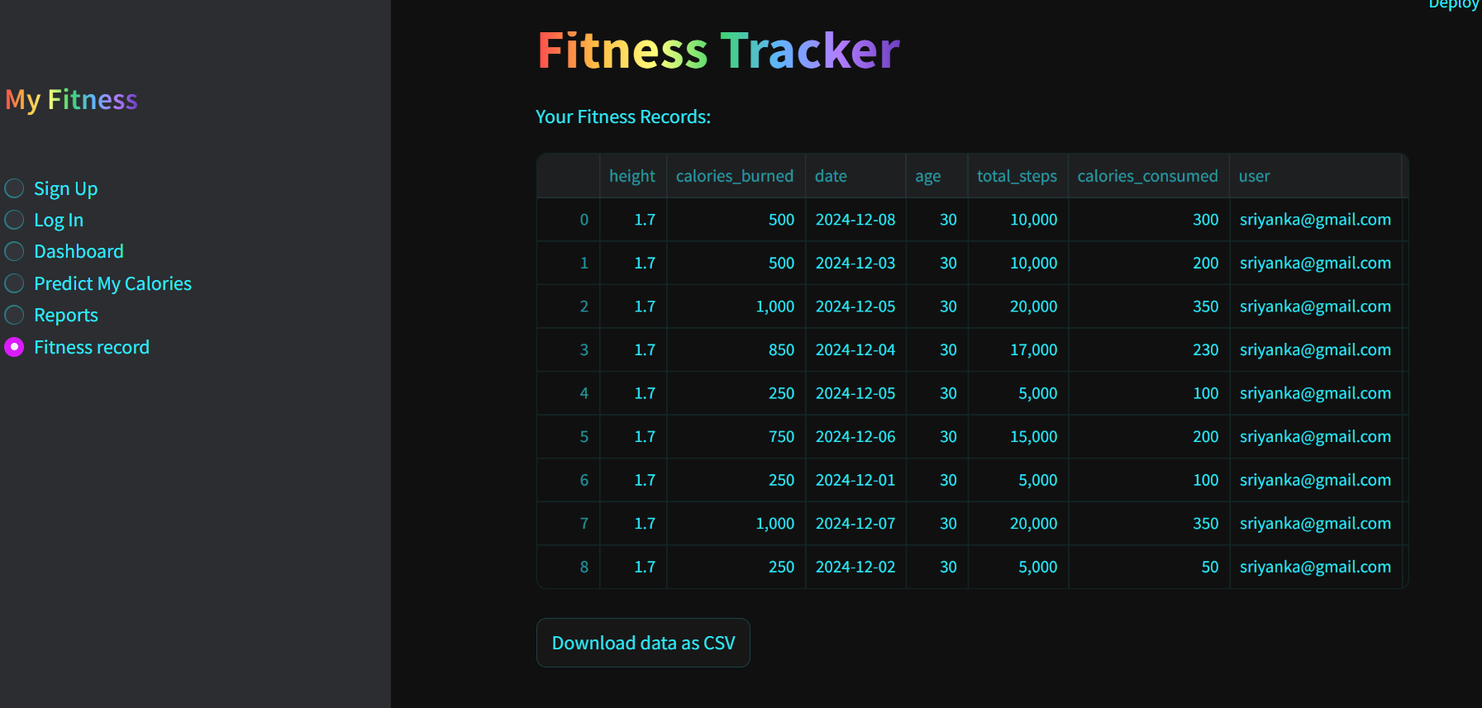
Fitness records
User can view detailed fitness records in tabular format.
Records can be downloaded as CSV file for offline analysis and personal records.

Slide 14
Technical overview
Frontend : streamlit
Backend : firebase Firestore
Machine Learning : Linear regression(Scikit-learn)
Programming language: python
Data Visualizations: Streamlit Charts ( Line and Bar )

Slide 15
Work flow
User interaction : users log in and input fitness data.
Data storage : data is securely stored in firebase firestore.
Data processing : calculations(ex: calories burn, weight loss) are performed.
Predictions: Machine learning models predict outcomes based on user inputs.
Reports: Summarized insights and visual trends are generated.

Slide 16
challenges
Data Dependency : predictions improve with more user data.
Model simplification : Linear regression might not capture complex patterns.
Scalability : system needs optimization for a larger user base.

Slide 17
Future enhancements
Advanced Machine Learning : Use more complex models for predictions.
Mobile App : Develop a mobile version for on-the-go tracking.
Wearable Integration : Sync with fitness devices(ex : Fitbit , Apple Watch).
Community Features : Enable users to participate in challenges and share progress.

Slide 18
Thank you

